Slide 1
Distribution System Transformers
ECpE Department
Dr. Zhaoyu Wang
1113 Coover Hall, Ames, IA
wzy@iastate.edu

Slide 2
Distribution System Transformers
Acknowledgement:
The slides are developed based in part on Electric Power and Energy Distribution Systems, Models, Methods and Applications, Subrahmanyan S. Venkata, Anil Pahwa, IEEE Press & Wiley, 2022
ECpE Department

Slide 3
1. Definition
Distribution transformers: Transformers with a rating of 1000 kVA or less are classified as distribution transformers. In a distribution system, distribution transformers are those that are located close to the loads and are used to reduce voltage to the utilization level, such as 120/240 V.
Power transformers: Transformers with a rating larger than 1000 kVA are grouped as power transformers. Power transformers are those that are located in substations. In some situations, for large industrial or commercial loads, power transformers can be deployed close to the loads.

Slide 4
1. Definition
Both types of transformers play important roles in the distribution system, with distribution transformers serving to provide power to customers and power transformers serving as the interface between transmission and distribution systems.

Slide 5
2. Types of Distribution Transformers
One way to classify distribution transformers is based on the medium employed for cooling and insulation:
Dry type: Uses air as cooling and insulation medium, commonly used for commercial or light industrial applications.
Liquid-filled: Uses oil as cooling and insulation medium, commonly used for residential service, pole-mounted for overhead feeders, pad-mounted or underground for underground feeders.

Slide 6
2. Types of Distribution Transformers
  Overhead transformers:
  A majority of transformers deployed in overhead distribution feeders are conventional or do not have any built‐in protection. They may have a fuse on the primary side for protection against overload and faults.
  Completely self‐protecting (CSP) transformers have fault, lightning, and overload protection built in them.
  Another variety of transformers called completely self‐protecting banked (CSPB) have all the protection features but also allow secondaries to be paralleled.

Slide 7
2. Types of Distribution Transformers
  Underground transformers:
  Low‐cost residential transformers for underground feeders are conventional with no protection.
  Subway transformers, which are designed for installation in vaults, can be either conventional or current protected.
  Subway transformers, which are designed for installation in vaults, can be either conventional or current protected.
  Network transformers, which are used in secondary network systems, have built‐in protection.

Slide 8
3. Standards
Temperature rise in a transformer is dependent on the amount of current it carries and the time duration of that current.
Transformers have a long life if the load on them does not exceed the rated load. However, they can carry current up to twice the rated current, but currents over the rated current accelerate aging and cause loss of life.

Slide 9
3. Standards
Therefore, overload is permitted only for short durations under emergencies. The larger the current, the higher the loss of life.
Hence, the allowed time for overload is reduced with increase in load to keep the oil and winding temperature rise within allowable limits.
Name plate ratings typically specify temperature rise rating based on these standards in addition to volt‐ampere (VA) rating, voltage ratings, and percent impedance.

Slide 10
3. Standards
Loading of Transformers
Types of Cooling
  OA – Oil‐Immersed Self‐Cooled
  OA/FA – Oil‐Immersed Self‐Cooled/Forced‐Air Cooled
  OA/FA/FOA – Oil‐immersed Self‐Cooled/Forced‐Air Cooled/Forced‐Oil Forced‐Air Cooled
  FOA – Oil‐Immersed Forced‐Oil Cooled with Forced‐Air Cooled
  OW – Oil‐Immersed Water Cooled
  FOW – Oil‐Immersed Forced‐Oil Cooled with Forced‐Water Cooled
  AA – Dry‐Type Self‐cooled
  AFA – Dry‐Type Forced‐Air Cooled
  AA/FA – Dry‐Type Self‐cooled/Forced‐Air Cooled
Terminal Markings and Polarity
Insulation Class

Slide 11
3.1 Loading of Transformers
Transformers are assigned a kVA rating. According to standards, the transformer can continuously carry a current corresponding to this kVA without exceeding an average winding temperature of 55 or 65 °C above the ambient temperature.
Older transformers were designed for 55°C temperature rise, while newer ones can withstand 65°C.
The nameplate rating also serves a useful commercial purpose by specifying the kVA at which guaranteed losses and regulation must be met. In service, however, a distribution transformer is rarely loaded continuously at its rated kVA but usually goes through a daily load cycle characterized by a short‐time peak load.

Slide 12
3.1 Loading of Transformers
The primary consideration of loading which determines the life of a particular transformer is the deterioration of insulation during its service life. The rate of deterioration is greatly influenced by the temperature to which the insulation is subjected.
For insulation used in liquid‐immersed transformers, the standards require hot‐spot temperature (the highest temperature on the windings) to be limited to 110 °C for 65 °C temperature rise transformers and 95 °C for 55 °C temperature rise transformers for normal life expectancy.
One solution to the cyclic loading problem would be to limit the peak load of the transformer to nameplate rating. However, this would result in uneconomical use of the transformer loading capability.

Slide 13
3.1 Loading of Transformers
There are two primary characteristics of the transformer that permit short‐time peak overloads to be carried without decreasing the expected life:
  The relatively long thermal time constant of the transformer: While the load on the transformer can increase very rapidly, the oil temperature increases much more gradually along an exponential curve with a time constant in the order of a few hours. The temperature differential between winding and oil increases to its ultimate value much more quickly, but the total winding temperature is held down by the oil. The magnitude and duration of the overload which can be carried without exceeding 110 or 95 °C degree hot‐spot temperature depend on the ambient temperature, initial loading, loss ratio, etc.

Slide 14
3.1 Loading of Transformers
  The thermal aging characteristics of insulation used in distribution transformers: Temperatures considerably above 110 °C (95 °C) can be carried for short periods of time without decrease in normal life expectancy, if this condition is offset by extended operation at temperatures below 110 °C (95 °C). In other words, the elevated temperatures do not cause failure of insulation but only increase the rate at which deterioration occurs.

Slide 15
3.2 Types of Cooling
Usually, all distribution transformers are self‐cooled. Forced‐oil and forced‐air cooling are invariably used for power transformers, which are used in substations. The basic types of cooling are referred to by different designations.
  OA (Oil-Immersed Self-Cooled):
  In this type of transformer, the insulating oil circulates by natural convection within a tank having smooth sides, corrugated sides, integral tubular sides, or detachable radiators.

Slide 16
3.2 Types of Cooling
  Smooth tanks are used for small distribution transformers, but because the losses increase more rapidly than the tank surface area as kVA capacity goes up, a smooth tank transformer larger than 50 kVA would have to be abnormally large to provide sufficient radiating surface.
  Integral tubular‐type construction is used up to about 3000 kVA and in some cases to larger capacities, though shipping restrictions usually limit this type of construction for the larger ratings.
  Above 3000 kVA, detachable radiators are usually supplied. Transformers rated 46 kV and below may also be filled with Inerteen fire‐proof insulating liquid, instead of oil. The OA transformer is a basic type and serves as a standard for rating and pricing other types.

Slide 17
3.2 Types of Cooling
  OA/FA (Oil-Immersed Self-Cooled/Forced-Air Cooled):
  This type of transformer is basically an OA unit with the addition of fans to increase the rate of heat transfer from the cooling surfaces, thereby increasing the permissible transformer output.
  The OA/FA transformer is applicable in situations that require short‐time peak loads to be carried recurrently, without affecting the normal expected transformer life.

Slide 18
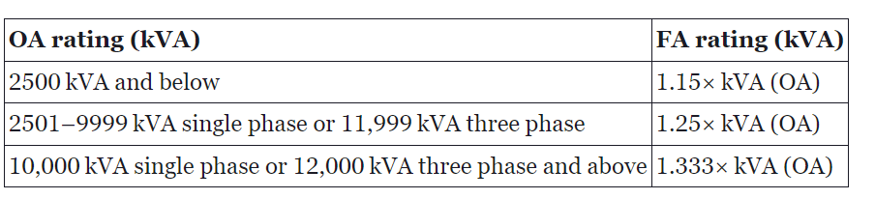
3.2 Types of Cooling
  This transformer may be purchased with fans already installed, or it may be purchased with the option of adding fans later.
  The higher kVA capacity attained by the use of fans is dependent on the self‐cooled rating of the transformer and may be calculated as shown in the Table. These ratings are standardized and are based on a hottest spot winding temperature rise of 65 °C.
Table: OA and FA ratings of transformers.

Slide 19
3.2 Types of Cooling
  OA/FA/FOA (Oil-Immersed Self-Cooled/Forced-Air Cooled/Forced-Oil Forced-Air Cooled):
  The rating of an oil‐immersed transformer may be increased from its OA rating by the addition of some combination of fans and oil pumps.
  Such transformers are normally built in the range of 10,000 kVA (OA) single phase or 12,000 kVA (OA) three phase and above. Increased ratings are defined in two steps, 1.333 and 1.667 times the OA rating, respectively.
  Recognized variations of these triple‐rated transformers are the OA/FA/FA and the OA/FA/FOA types. Automatic controls responsive to oil temperature are normally used to start the fans and pumps in a selected sequence as transformer loading increases.

Slide 20
3.2 Types of Cooling
  FOA (Oil-Immersed Forced-Oil Cooled with Forced-Air Cooled):
  This type of transformer is intended for use only when both oil pumps and fans are operating. Under these conditions the transformer may carry any load up to full rated kVA.
  Some designs are capable of carrying excitation current with no fans or pumps in operation, but this is not universally true. Heat transfer from oil to air is accomplished in external oil‐to‐air heat exchangers.

Slide 21
3.2 Types of Cooling
  OW (Oil-Immersed Water Cooled):
  In this type of water‐cooled transformer, the cooling water runs through the coils of a pipe which are in contact with the insulating oil of the transformer.
  The oil flows around the outside of these pipe coils by natural convection, thereby effecting the desired heat transfer to the cooling water. This type has no self‐cooled rating.
  FOW (Oil-Immersed Forced-Oil Cooled with Forced-Water Cooled):
  External oil‐to‐water heat exchangers are used in this type of unit to transfer heat from oil to cooling water; otherwise, the transformer is similar to the FOA type.

Slide 22
3.2 Types of Cooling
  AA (Dry-Type Self-Cooled):
  Dry‐type transformers, available at voltage ratings of 15 kV and below, contain no oil or other liquid to perform insulating and cooling functions.
  Air is the medium that surrounds the core and coils, and cooling must be accomplished primarily by air flow inside the transformer. The self‐cooled type is arranged to permit circulation of air by natural convection.

Slide 23
3.2 Types of Cooling
  AFA (Dry-Type Forced-Air Cooled):
  This type of transformer has a single rating, based on forced circulation of air by fans or blowers.
  FFA (Dry-Type Forced-Air Forced-Air Cooled):
  This design has one rating based on natural convection and a second rating based on forced circulation of air fans or blowers.

Slide 24
Notes:
Different cooling methods have different advantages and disadvantages.
OA and OA/FA are widely used for distribution transformers.
OA/FA/FOA and FOA are used for power transformers in substations.
Dry-type transformers have lower fire risk, but also lower temperature rise capacity and higher noise levels.

Slide 25
Notes:
Forced-air and forced-oil cooled transformers can handle higher temperatures and higher kVA ratings but are more expensive to maintain.
Water-cooled transformers have high cooling efficiency but require a water supply and treatment system.
Considerations for choosing a cooling method include cost, maintenance, size, environment, and risk of fire.

Slide 26
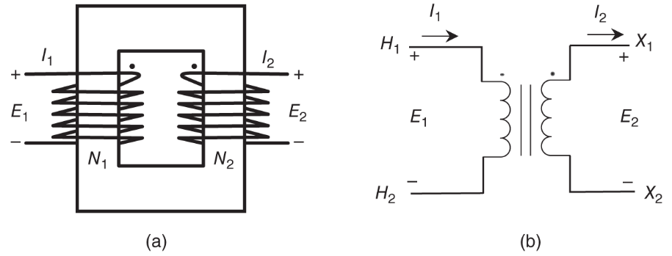
3.3 Terminal Markings and Polarity
High-voltage terminals are marked as H1, H2, and so on, while the low-voltage terminals are labeled as X1, X2, and so on.
The dot marking (•) indicates the polarity of the voltages on the windings.
Two‐winding diagram (a) and schematic (b) of a single‐phase transformer

Slide 27
3.4 Insulation Class
The insulation class of a transformer defines the dielectric test the unit can withstand, which is usually defined as a number in kV.
The number corresponds to the maximum‐rated voltage between terminals for phase‐to‐phase connection of the highest rated voltage that falls within the particular insulation class.
For example, a transformer for connection in either wye or delta on a 69‐kV system would be in the 69‐kV insulation class.

Slide 28
3.4 Insulation Class
An exception to the rule stated above applied to single‐phase transformers with voltage ratings 8.66 kV and below. These are insulated for voltages corresponding to the wye connection.
Hence, for transformers with delta connection, classification in one class higher is necessary.
Dielectric test consists of impulse, applied potential, or induced voltage tests. The basic insulation level (BIL) is the highest standard impulse wave (1.2 × 50 ms) that a transformer can withstand.

Slide 29
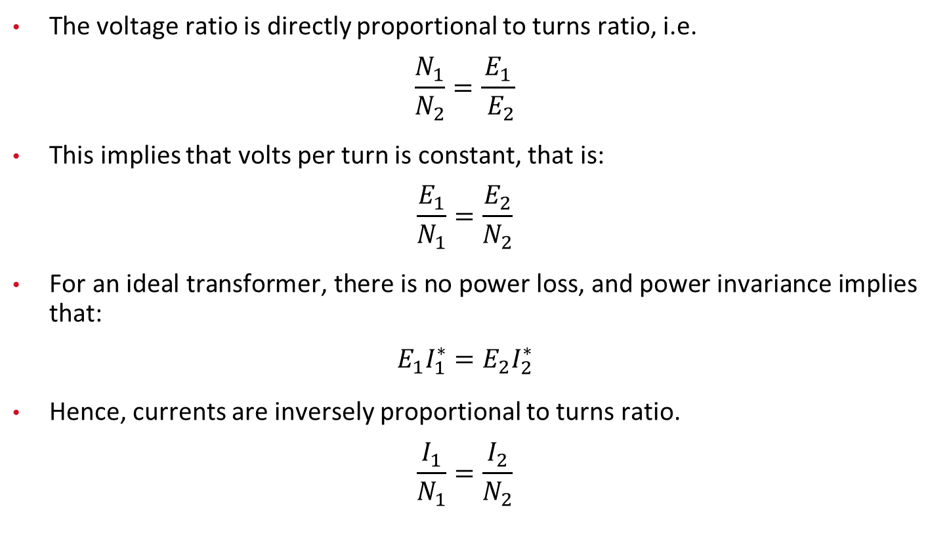
4. Single-Phase Transformers
The voltage ratio is directly proportional to turns ratio, i.e.
$$\frac{N_{1}}{N_{2}}=\frac{E_{1}}{{ E}_{2}}$$
This implies that volts per turn is constant, that is:
$$\frac{E_{1}}{N_{1}}=\frac{E_{2}}{N_{2}}$$
For an ideal transformer, there is no power loss, and power invariance implies that:
$$E_{1}I_{1}^{∗}=E_{2}I_{2}^{∗}$$
Hence, currents are inversely proportional to turns ratio.
$$\frac{I_{1}}{N_{1}}=\frac{I_{2}}{N_{2}}$$

Slide 30
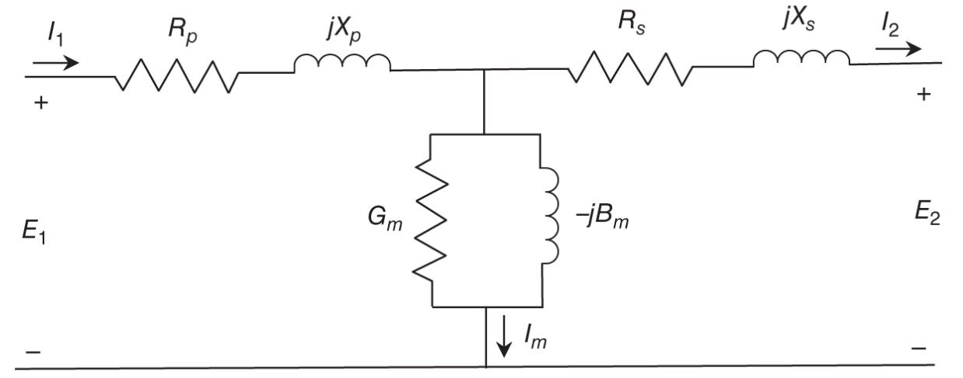
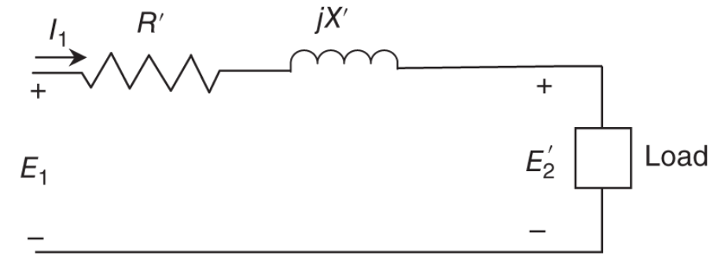
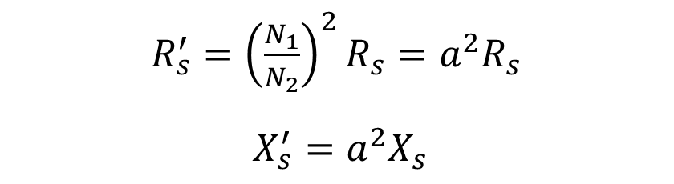

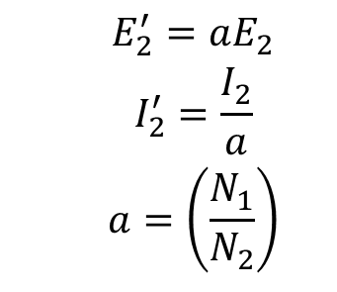
4.1 Model for a Single-Phase Transformer
Practical transformers are not ideal, therefore modeling of a single‐phase transformer accounts for various resistances and inductances associated with it.
$\begin{matrix}R_{s}^{′}={\left(\frac{N_{1}}{N_{2}}\right)}^{2}R_{s}=a^{2}R_{s} \\ \end{matrix}$
$X_{s}^{′}=a^{2}X_{s}$
$$\begin{matrix} & E_{2}^{′}=aE_{2} \\ & I_{2}^{′}=\frac{I_{2}}{a} \\ & a=\left(\frac{N_{1}}{N_{2}}\right)\end{matrix}$$
Fig: Model of a single-phase transformer
Fig: Equivalent model of a single-phase transformer
where $a$ is the turns ratio of the windings, and $R_{s}^{′}$ and $X_{s}^{′}$ are the resistance and reactance of the secondary side referred to the primary side.

Slide 31

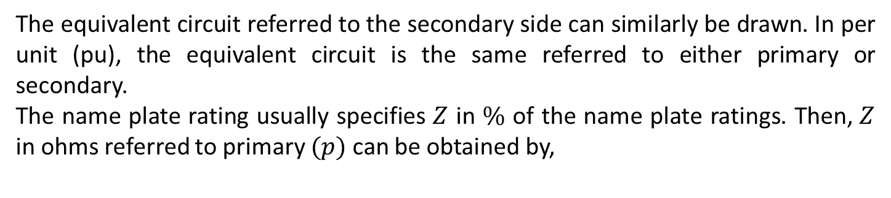
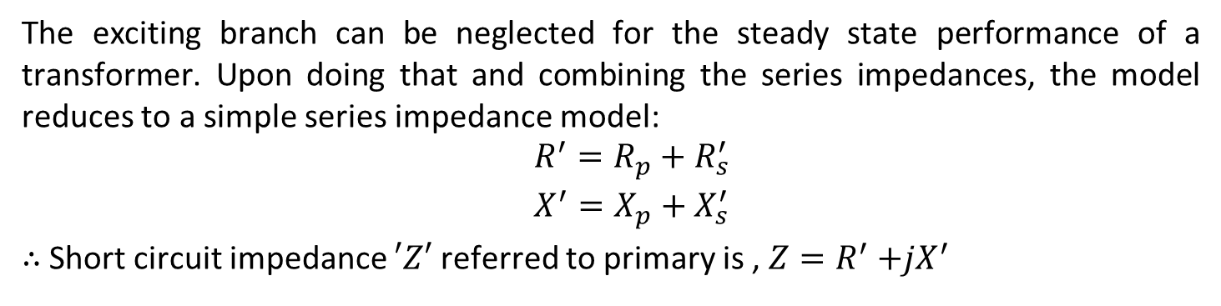
4.1 Model for a Single-Phase Transformer
The exciting branch can be neglected for the steady state performance of a transformer. Upon doing that and combining the series impedances, the model reduces to a simple series impedance model:
$$\begin{matrix} & R^{′}=R_{p}+R_{s}^{′} \\ & X^{′}=X_{p}+X_{s}^{′}\end{matrix}$$
$∴$ Short circuit impedance $′Z′$ referred to primary is , $Z=R^{′}{+jX}^{′}$
The equivalent circuit referred to the secondary side can similarly be drawn. In per unit (pu), the equivalent circuit is the same referred to either primary or secondary.
The name plate rating usually specifies $Z$ in $\%$ of the name plate ratings. Then, $Z$ in ohms referred to primary $(p)$ can be obtained by,
$$Z( \text{ohms} )=\frac{Z(\%)}{100}\frac{{\left({kV}_{{\text{rated} }_{p}}\right)}^{2}}{{ \text{MVA} }_{\text{rated} }}$$

Slide 32
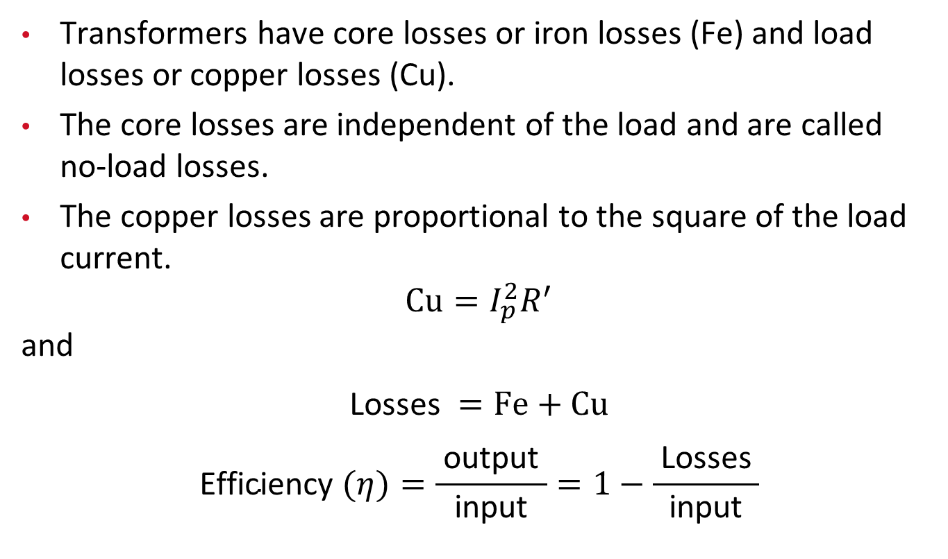
4.2 Performance Analysis
Transformers have core losses or iron losses (Fe) and load losses or copper losses (Cu).
The core losses are independent of the load and are called no‐load losses.
The copper losses are proportional to the square of the load current.
$$Cu=I_{p}^{2}R^{′}$$
and
$$\text{Losses} =Fe+Cu$$
$$\text{Efficiency} (η)=\frac{ \text{output} }{ \text{input} }=1−\frac{ \text{Losses} }{ \text{input} }$$

Slide 33
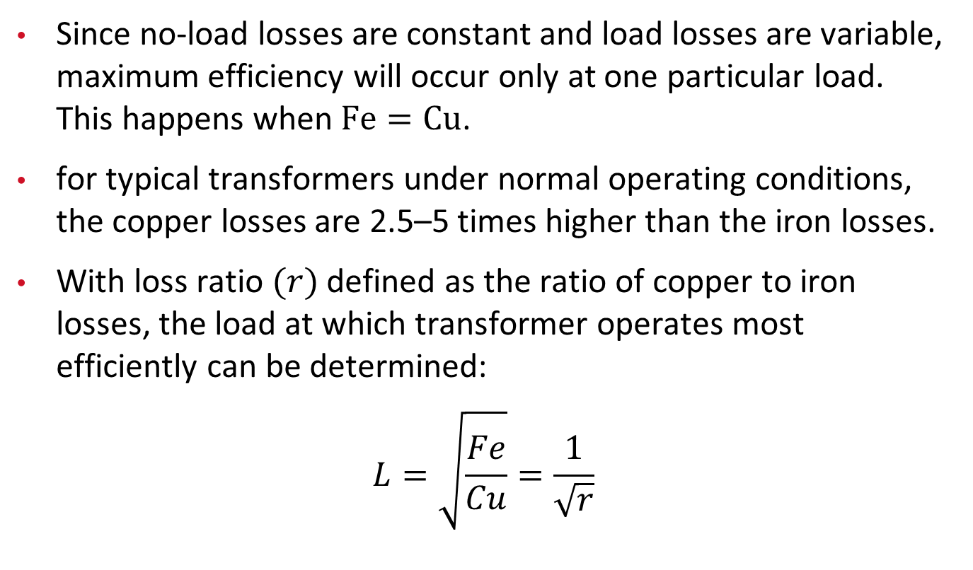
4.2 Performance Analysis
Since no-load losses are constant and load losses are variable, maximum efficiency will occur only at one particular load. This happens when $Fe=Cu$.
for typical transformers under normal operating conditions, the copper losses are 2.5–5 times higher than the iron losses.
With loss ratio $(r)$ defined as the ratio of copper to iron losses, the load at which transformer operates most efficiently can be determined:
$$L=\sqrt{\frac{Fe}{Cu}}=\frac{1}{\sqrt{r}}$$

Slide 34
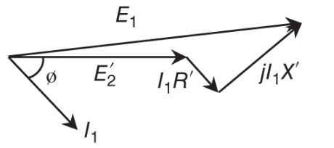
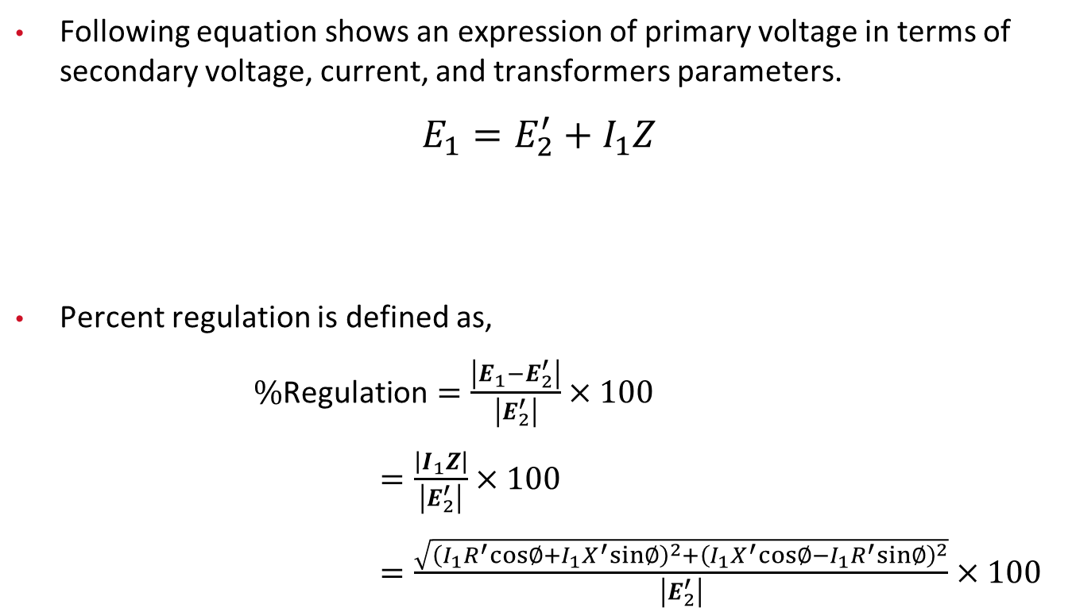

4.3 Regulation
Following equation shows an expression of primary voltage in terms of secondary voltage, current, and transformers parameters.
$$E_{1}=E_{2}^{′}+I_{1}Z$$
Percent regulation is defined as,
$\%\text{Regulation}=\frac{\left|E_{1}−E_{2}^{′}\right|}{\left|E_{2}^{′}\right|}×100$
$=\frac{\left|I_{1}Z\right|}{\left|E_{2}^{′}\right|}×100$
$=\frac{\sqrt{{\left(I_{1}R^{′}cos∅+I_{1}X^{′}sin∅\right)}^{2}+{\left(I_{1}X^{′}cos∅−I_{1}R^{′}sin∅\right)}^{2}}}{\left|E_{2}^{′}\right|}×100$
Fig: Phasor Diagram,
The load is inductive, with current lagging the voltage by angle $∅$

Slide 35
4.4 Taps
The output voltage of a transformer can be changed by changing the turns ratio between the primary and secondary windings, which can be done by tapping the primary winding at various points.
Primary winding taps perform two main functions:
  They can be used to compensate for the voltage drop caused by resistance (R′) and leakage reactance (X′).
  They can be used so that a single transformer will operate on primary systems with slightly different voltage levels. For example, a transformer with properly selected taps will operate on either 2160 or 2400 V primary system.
Secondary winding taps can also perform similar functions on the secondary side of the transformer.

Slide 36
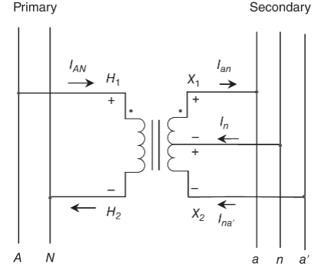
5. Distribution Transformer Connections (Single Phase)
A single‐phase distribution transformer can have different connections, depending on the type of load it serves.
If all the loads on the secondary side have the same voltage, a simple two‐winding transformer is used.
However, homes in the United States have loads that operate at 120 or 240 V. Large‐capacity loads, such as air conditioners and clothes washers, operate at 240 V, and the other loads in the same house operate at 120 V.
Fig: Center-tapped single-phase distribution transformer

Slide 37
5. Distribution Transformer Connections (Single Phase)
To facilitate supplying both 120 and 240 V to consumers from a single transformer, single‐phase distribution transformers are designed with the midpoint of the secondary grounded, as shown in the Figure.
This connection is called series, multiple secondary, or three‐wire secondary; 7200 V primary to 120/240 V on the secondary is a good example of such a transformer.
Typically, loads on the two circuits are distributed to create a balance between the two circuits. However, practically, it is impossible to have a balance under normal operation. In such cases, the current in the neutral is the difference between the currents flowing in the two circuits.

Slide 38
5. Distribution Transformer Connections (Single Phase)
In certain applications, where variable secondary voltages are desired, a booster transformer is used.
This transformer is similar to an autotransformer. It has low percent Z, low cost, and high efficiency. One disadvantage is that it has electrical connection between the two sides of the transformer.
To increase the capacity, two transformers can be operated in parallel under certain conditions. Specifically, they must have the same turns ratio and must be connected to the same primary phase. Also, to maximize the capability, they should have nearly equal impedances.

Slide 39
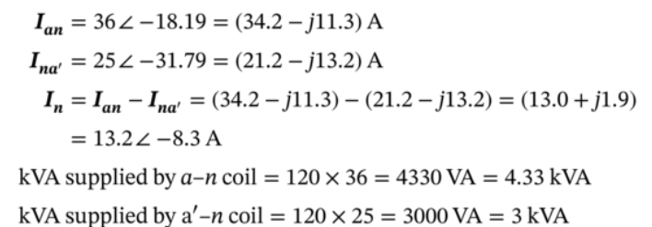
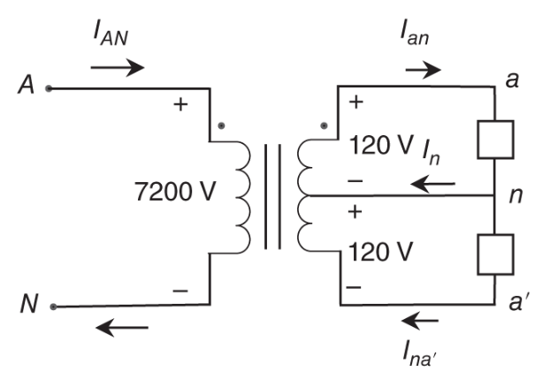
5.1 Example
Consider a transformer with 120 V loads connected, as shown in the Figure. Under balanced conditions, no neutral current flows, but under unbalanced conditions, a neutral current would flow, sometimes substantial. In fact, the amount of neutral current is a direct measure of unbalance.
Consider the load across phases a to n to be 36 A at 0.95 pf lagging, and the load across phases a′ to n to be 25 A 0.85 pf lagging. Determine the current flow in the neutral wire and the load supplied by each secondary coil of the transformer. Also, determine the kVA rating of this transformer such that the thermal rating of it is not exceeded.
The total kVA is 7.33 kVA. Rounding it off to the next higher available rating gives the transformer rating of 10 kVA.
Fig: Three‐wire secondary distribution transformer with 120 V loads.

Slide 40
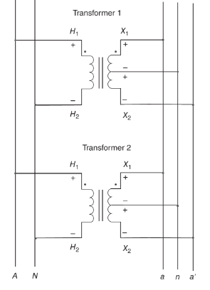
5.2 Parallel Operation of Three-Wire Transformer
Two single‐phase, three‐wire transformers can be connected in parallel to supply increased load if the following conditions are met:
  They must have the same primary and secondary voltage ratings and therefore the same turns ratio.
  They must be connected to the same primary phase.
  They must be connected to the same secondary phase.
Fig: Two three-wire secondary distribution transformers connected in parallel

Slide 41
5.2 Parallel Operation of Three-Wire Transformer
However, they may have different kVA ratings and percent leakage impedance, though not too different from each other.
To maximize the total load delivered without exceeding the thermal limits, they should have nearly equal impedances.
Fig: Two three-wire secondary distribution transformers connected in parallel

Slide 42
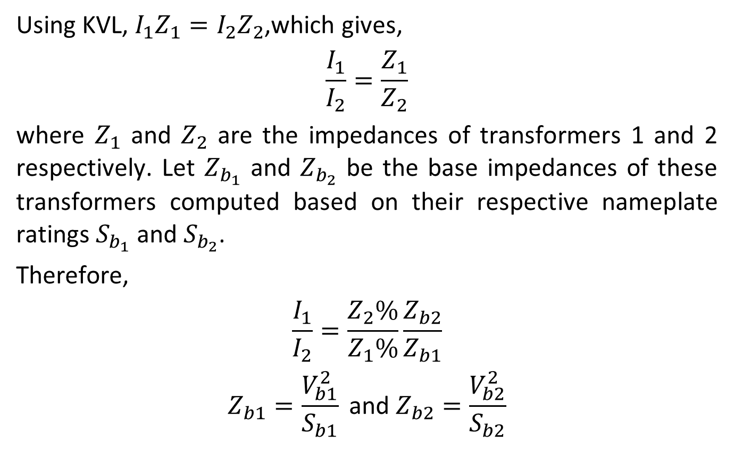
5.2 Parallel Operation of Three-Wire Transformer
Using KVL, ${I_{1}Z}_{1}=I_{2}Z_{2}$,which gives,
$$\frac{I_{1}}{I_{2}}=\frac{Z_{1}}{Z_{2}}$$
where $Z_{1}$ and $Z_{2}$ are the impedances of transformers 1 and 2 respectively. Let $Z_{b_{1}}$ and $Z_{b_{2}}$ be the base impedances of these transformers computed based on their respective nameplate ratings $S_{b_{1}}$ and $S_{b_{2}}$.
Therefore,
$$\begin{matrix}\frac{I_{1}}{I_{2}}=\frac{Z_{2}\%}{Z_{1}\%}\frac{Z_{b2}}{Z_{b1}} \\ Z_{b1}=\frac{V_{b1}^{2}}{S_{b1}} \text{and} Z_{b2}=\frac{V_{b2}^{2}}{S_{b2}}\end{matrix}$$

Slide 43
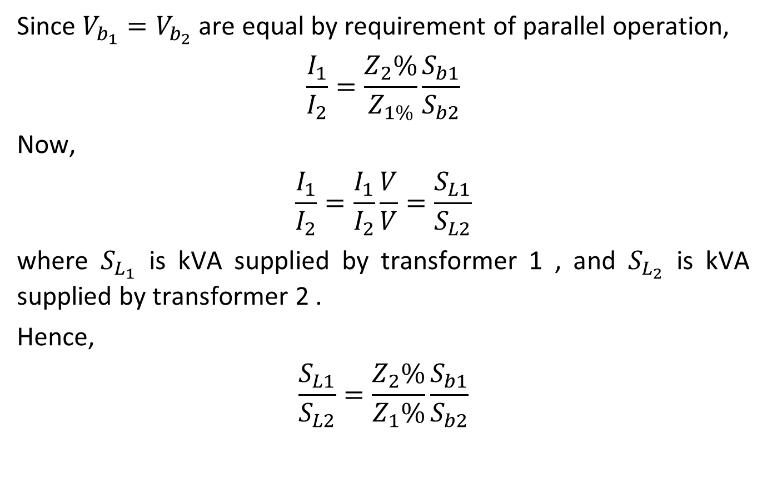
5.2 Parallel Operation of Three-Wire Transformer
Since $V_{b_{1}}=V_{b_{2}}$ are equal by requirement of parallel operation,
$$\frac{I_{1}}{I_{2}}=\frac{Z_{2}\%}{Z_{1\%}}\frac{S_{b1}}{S_{b2}}$$
Now,
$$\frac{I_{1}}{I_{2}}=\frac{I_{1}}{I_{2}}\frac{V}{V}=\frac{S_{L1}}{S_{L2}}$$
where $S_{L_{1}}$ is kVA supplied by transformer 1 , and $S_{L_{2}}$ is kVA supplied by transformer 2 .
Hence,
$$\frac{S_{L1}}{S_{L2}}=\frac{Z_{2}\%}{Z_{1}\%}\frac{S_{b1}}{S_{b2}}$$

Slide 44
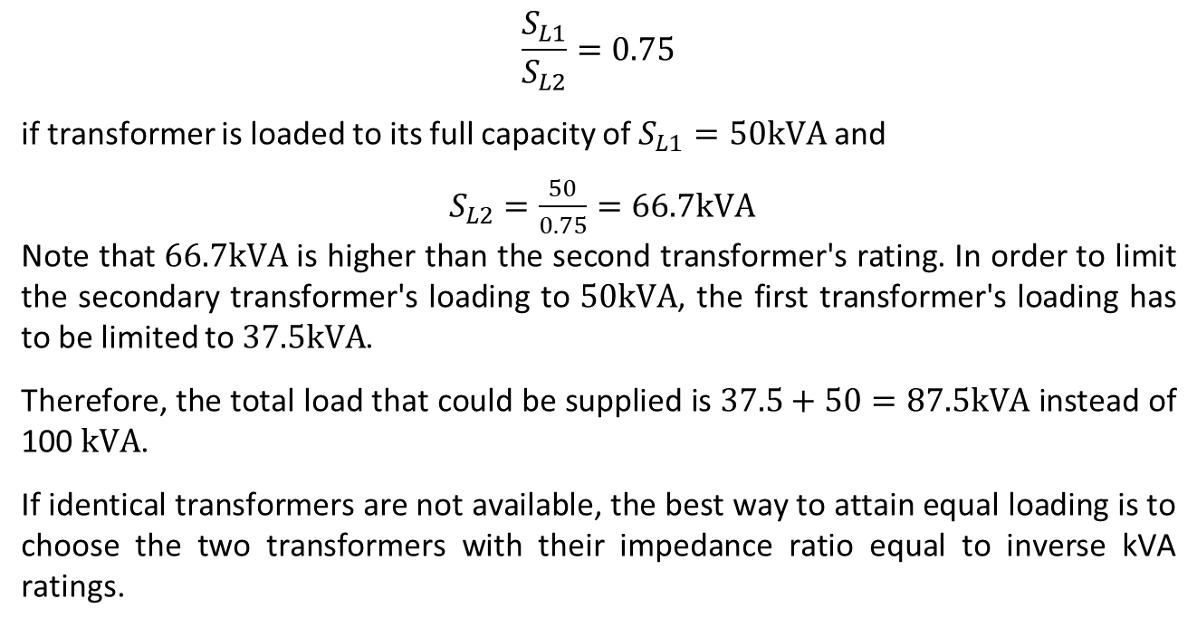
Example
Consider that a 50‐kVA transformer of 4% impedance is connected in parallel with a 50‐kVA transformer of 3% impedance. Find the total load that these transformers can deliver.
$$\frac{S_{L1}}{S_{L2}}=0.75$$
if transformer is loaded to its full capacity of $S_{L1}=50kVA$ and
$S_{L2}=\frac{50}{0.75}=66.7kVA$
Note that $66.7kVA$ is higher than the second transformer's rating. In order to limit the secondary transformer's loading to $50kVA$, the first transformer's loading has to be limited to $37.5kVA$.
Therefore, the total load that could be supplied is $37.5+50=87.5kVA$ instead of 100 $kVA$.
If identical transformers are not available, the best way to attain equal loading is to choose the two transformers with their impedance ratio equal to inverse kVA ratings.

Slide 45
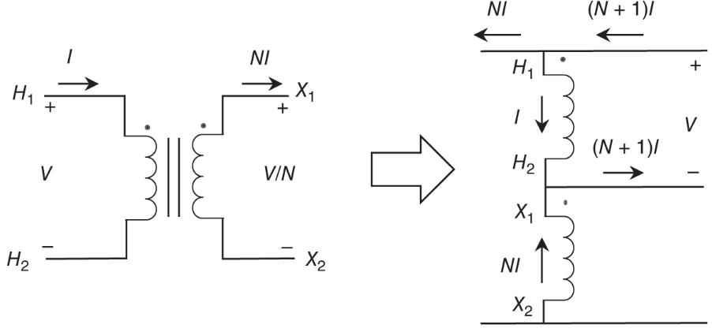
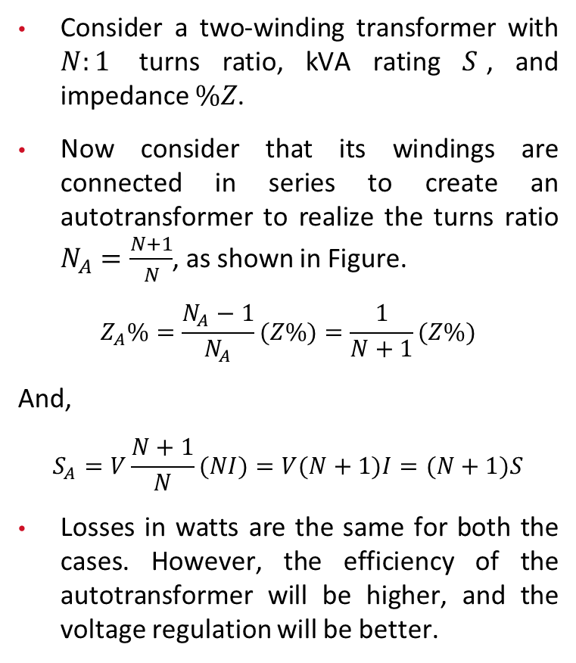
5.3 Single Phase Autotransformers
Consider a two-winding transformer with $N:1$ turns ratio, kVA rating $S$, and impedance $\%Z$.
Now consider that its windings are connected in series to create an autotransformer to realize the turns ratio $N_{A}=\frac{N+1}{N}$, as shown in Figure.
$$Z_{A}\%=\frac{N_{A}−1}{N_{A}}(Z\%)=\frac{1}{N+1}(Z\%)$$
And,
$$S_{A}=V\frac{N+1}{N}(NI)=V(N+1)I=(N+1)S$$
Losses in watts are the same for both the cases. However, the efficiency of the autotransformer will be higher, and the voltage regulation will be better.
Fig: Two-winding transformer and its connection to create an autotransformer

Slide 46
6. Three-Phase Transformer Connections
The following connections are well known and widely used for power transformers in distribution systems:
Wye-Delta:
  This connection is the most commonly used in transmission and distribution systems.
  It blocks the flow of the third harmonic and provides a neutral for grounding.
  It is used with a wye connection on the high-voltage side in transmission systems, and with a wye connection on the low-voltage side in distribution systems.

Slide 47
6. Three-Phase Transformer Connections
Delta-Delta:
  This connection is used in three-wire systems without a neutral.
  It blocks the flow of the third harmonic and can be operated at reduced capacity as an open delta with two of the windings functioning.
  However, it lacks a neutral, which creates challenges for ground-fault protection.

Slide 48
6. Three-Phase Transformer Connections
Wye-Wye:
  This connection can be used only if a neutral is available on both sides.
  It allows the flow of the third harmonic, which can be a problem.
  It also has poor voltage regulation for single-phase loads and can cause neutral inversion.

Slide 49
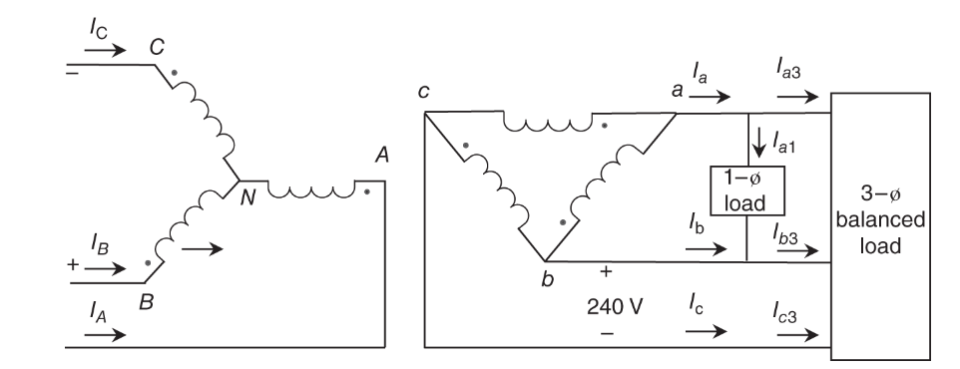
6.1 Analysis of Y/ Transformer with Unbalanced Load
Usually, such three‐phase transformers are made of three, similar single‐phase units to realize the desired type of connection. The aim is to analyze the three‐phase transformer in the presence of a single‐phase lighting type of load.
The figure shows a transformer with three‐phase balanced load as well as a single‐phase load connected across phases a and b on the low‐voltage side. We consider an example to compute the high‐voltage side currents and kVA rating of each single‐phase transformer unit.
I_{A}, I_{B}, and I_{C} are not balanced due to the single-phase load. Therefore, kVA ratings of each single-phase transformer units are not identical. Since the neutral is grounded, it is not at zero potential. However,
I_{A} + I_{B} + I_{C} = 0 and I_{N} = 0
If the neutral is not grounded, I_{N} will not be zero.
Applying the superposition principle, the winding currents on the LV side can be obtained.

Slide 50
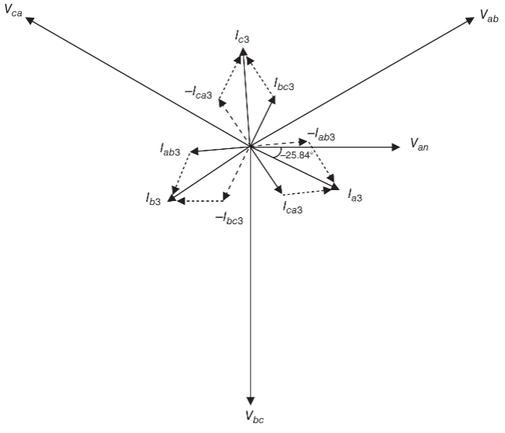
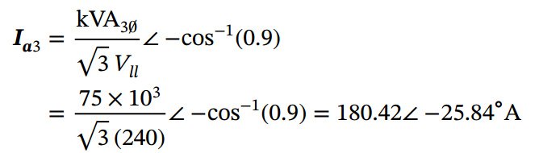
Example
Consider a transformer with line‐to‐line voltage to be 12.47 kV on the HV side and 240 V on the LV side. Let the three‐phase load be 75 kVA at 0.9 pf lagging, and the single‐phase load be 25 kVA at unity pf. Find kVA load supplied by each phase and pf of each phase from the primary side.
Three-phase load:
Choose Van as the reference voltage, which gives Vab = 240∠30∘. Now, we can draw a phasor diagram showing all the voltages and current due to the three-phase load as shown in Figure 2.10. Hence,
Figure 2.10.

Slide 51
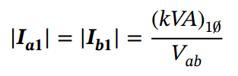
Example
Due to the balanced nature of the three-phase load, we can obtain I_{b3} and I_{c3}:
Then, the winding currents can be obtained, or
Single-phase load:
Therefore,

Slide 52
Example
This current flows into the transformer through terminal “b” and gets split into two parts while flowing toward “a”: two‐thirds of it flow directly to “a” from “b,” and one‐third of it takes the path “b”–“c”–“a” due to the current division. Therefore
Applying the superposition principle, the secondary phase currents of the transformer can be obtained:

Slide 53

Example
Note that these currents are unbalanced. With the transformation ratio of $\frac{12470√3}{240}$ , the primary currents are
The kVA supplied by each phase is
The power factor of each phase as seen from the Y side is

Slide 54
6.2 Analysis of Y/Y Transformer
Y/Y connection scheme is not commonly used with isolated neutrals due to the instability caused by:
Magnetizing currents:
  Unbalances in magnetizing current can occur due to differences in the iron characteristics of the three single-phase transformer cores or in the shell type of core.
  If the transformer neutral is isolated, this unbalance is not significant. However, if the transformer neutral is grounded, the asymmetry is impressed on the line capacitance to ground and is enhanced when the line charging current is comparable to the magnetizing current of the transformer.

Slide 55
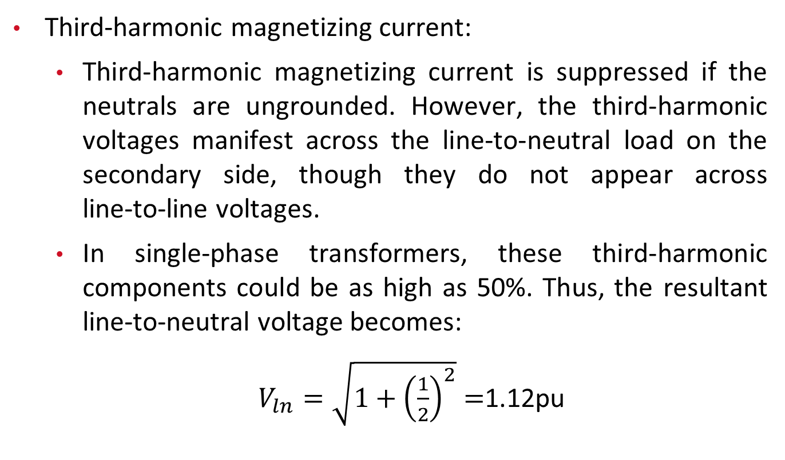
6.2 Analysis of Y/Y Transformer
Third-harmonic magnetizing current:
  Third‐harmonic magnetizing current is suppressed if the neutrals are ungrounded. However, the third‐harmonic voltages manifest across the line‐to‐neutral load on the secondary side, though they do not appear across line‐to‐line voltages.
  In single‐phase transformers, these third‐harmonic components could be as high as 50%. Thus, the resultant line‐to‐neutral voltage becomes:
  $V_{ln}=\sqrt{1+{\left(\frac{1}{2}\right)}^{2}}$ $=$1.12pu

Slide 56
6.2 Analysis of Y/Y Transformer
Line‐to‐neutral load:
  Line‐to‐neutral or single‐phase loads could cause neutral instability in ungrounded Y–Y transformer schemes. The line‐to‐neutral voltage effectively goes to zero on an ungrounded transformer scheme.
  Line‐to‐neutral or single‐phase loads could cause neutral instability in ungrounded Y–Y transformer schemes. The line‐to‐neutral voltage effectively goes to zero on an ungrounded transformer scheme.

Slide 57
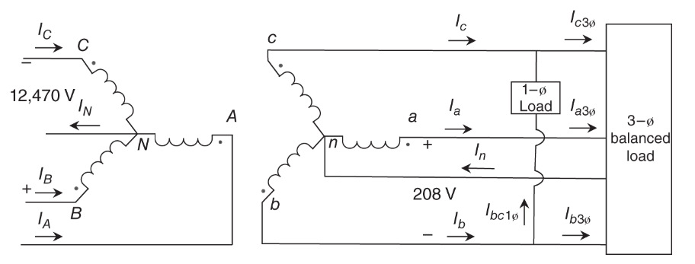

Example
Consider a transformer rated 500 kVA, 12.47 kV/208 V. There is a balanced three‐phase load of 400 kVA at 0.94 pf lagging and a load of 100 kVA at 0.85 pf lagging across phases b and c on the low‐voltage side of the transformer as shown in Figure 2.11. Find $I_{A}$, $I_{B}$, $I_{C}$ $,I_{N},$ and $I_{n}.$
Fig: Y/Y transformer with unbalanced loading.

Slide 58
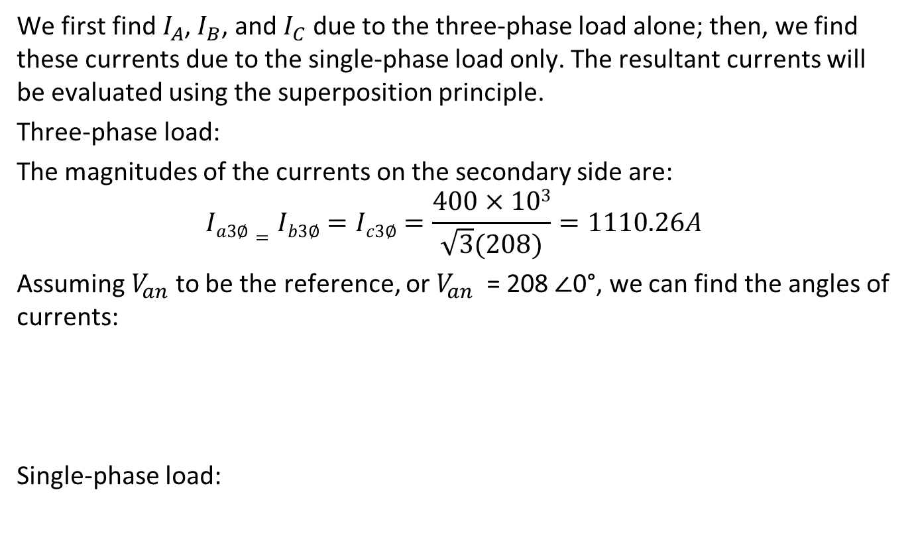
Solution
We first find $I_{A}$, $I_{B}$, and $I_{C}$ due to the three‐phase load alone; then, we find these currents due to the single‐phase load only. The resultant currents will be evaluated using the superposition principle.
Three‐phase load:
The magnitudes of the currents on the secondary side are:
$$Ia3∅=Ib3∅=Ic3∅=\frac{400×103}{\sqrt{3}(208)}=1110.26A$$
Assuming $V_{an}$ to be the reference, or $V_{an}$ = 208 ∠0°, we can find the angles of currents:
Single‐phase load:

Slide 59

Solution
Since $E_{bc}$ lags $E_{an}$ by 90°:
Also:
Therefore, the resultant currents are:
The turns ratio of the transformer is 12470 : 208 or 59.95 : 1.
Hence, the currents on the primary side can be computed:

Slide 60
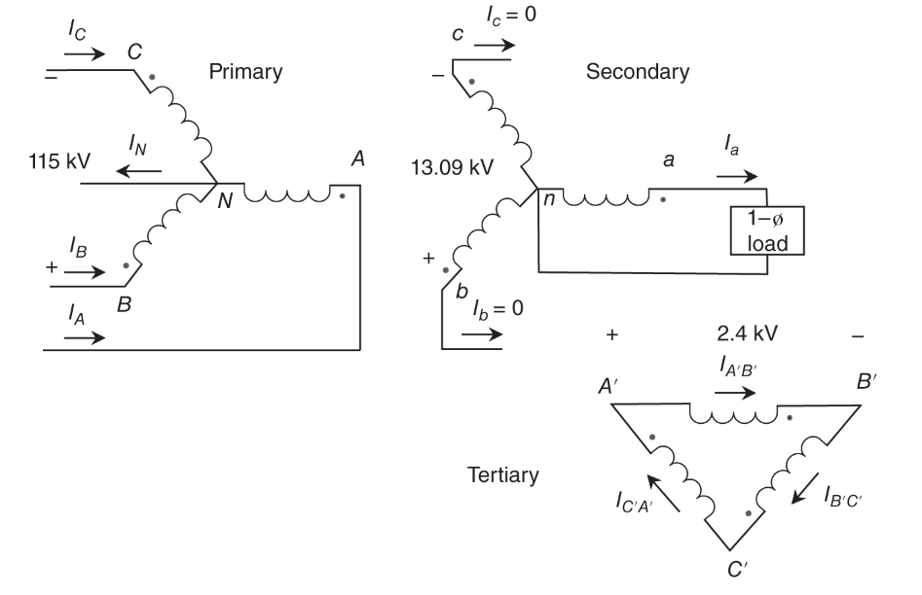

6.3 Three-winding Transformer
Three‐winding transformers are used in special situation, such as auxiliary supply. For example, the transformer shown in Figure has the secondary side rated at 13.09 kV (L–L) and the tertiary side rated at 2.4 kV (L–L). A single‐phase load of 5 MVA of 0.95 pf lagging is connected across phase a and the neutral of the secondary winding. The goal is to determine the currents on the primary side as well as in the tertiary windings with $V_{an}$ as the reference voltage.
Fig: A three‐winding transformer with single‐phase load.

Slide 61

Solution
For flux balance:
or:
All the currents circulating in the tertiary windings are equal. Therefore:

Slide 62
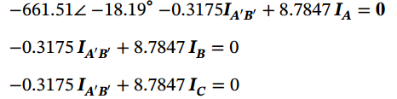

Solution
For the specified voltages in this example
Upon substituting the known numerical values into (2.31), (2.32), and (2.33),
we get
Therefore
$$I_{B}=I_{C}$$
Since $I_{A}+I_{B}+I_{C}=0$ , we get: $I_{A}=−2I_{B}=−2I_{C}$
Substituting this in (2.36) gives$IA^{′}B^{′}=−13.8342IA$. Further substituting this in (2.36) gives

Slide 63
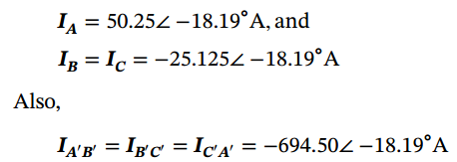
Solution
Substituting this in (2.36) gives$IA^{′}B^{′}=−13.8342IA$. Further substituting this in (2.36) gives

Slide 64
Thank You!

